Slide 1


Proof Of Concept
UI Test Automation
Framework: JavaScript + Jest + Playwright
Use Cases: Main Parameter / Review Order / Provisioning/Deletion
@ Mahendra Selukar

Slide 2




Recording
Demo

Slide 3
☑ Simple setup and easy to use
☑ Support for all Modern browsers.
☑ Powerful automation capabilities including working with dark mode context.
☑ Auto-waiting (range of actionability checks)
☑ Super-fast and Reliable test execution.
☑ Extended methods for selectors beyond xpath and css.
☑ Inbuilt mechanism for capturing screenshots, videos, har, network tracing, api mocking
☑ Handy Inspector for developing and debugging asynchronous test.
☑ Parallel and cross browser support without any complex configuration.
☑ Easily integrate with any third party reporters (allure,jest-html,jest-stare)
☑ Integration with slack/Jenkins/Circle/Bitbucket/Azure Pipelines/GitLab/Travis
☑ Extendable with third part test runners like Jest/Jasmine/Mocha
☑ Strong road-map for more new features like device testing
Pros

Slide 4
Challenges
The design document of playwright suggest to run each test on isolated environment, this involves launching browser and re-login to application.
To overcome the challenge, we extended playwright with jest unit testing framework that is offering jest-playwright-preset wrapper.
Retry Mechanism for failed tests

Slide 5
FW Design
Test Data
Tests
Global Objects
HTML/XML
Test Env SetUp
Trace
Helpers
Page Objects
Common Methods
Har
Browser
Contexts
Page
Videos
Coverage
Playwright Config
Playwright
Jest Config
jest
Logs/OrderIds
Reports

Slide 6
Future Enhancement
Implement features of playwright like api mocking, complete network interception if any use case.
Retry mechanism for flaky tests
Integration with majestic gui for running tests

Slide 7
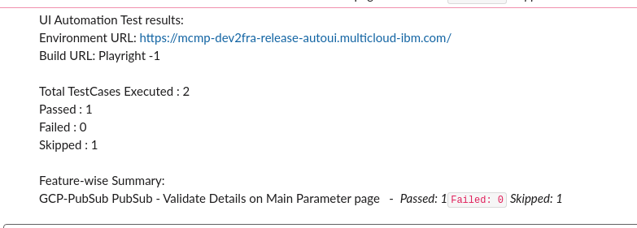
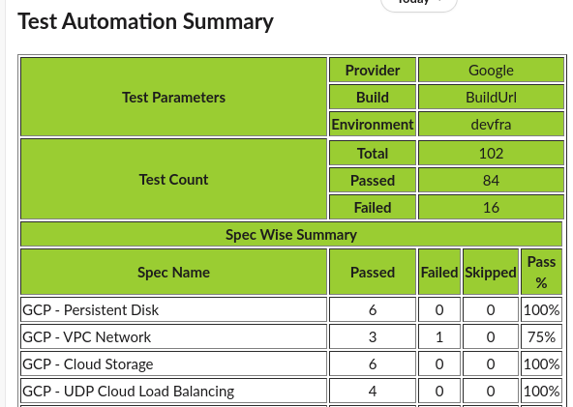
Slack Reports

Slide 8
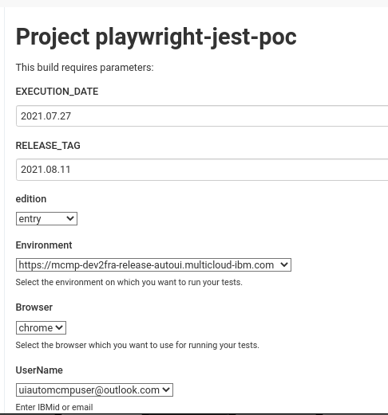
Jenkins job

Slide 9


Slide 10
Back-up

Slide 11
Install/Setup – one line installation that auto downloads all browser dependencies.
Jest with Jasmine framework supporting all capabilities of existing framework.
Optimized and clean spec files without repeatable code.
Page Objects are defined globally once and are accessible across framework.
Custom Test reporter to report test steps to allure html report and print the same step on console.
Captures coverage of spec file from codebase.
Re-use of authentication details, helpful for local test run as it eliminates the need of re-login.
Huge library of selectors on top of css for uniquely identifying elements, no need to mention explicitly if element is of type xpath or css or any.
Detailed HTML reports (Allure, jesthtml,jest-stare and coverage report), logs
Video recording, har file of spec execution and screenshots of failed tests.
Trace Viewer , allows detailed analysis of test execution. Trace viewer file captures screenshots of test step before and after execution, network log if action is supporting any api, time taken to complete api and many more.
Debugging of asynchronous code is now very simpler with playwright inspector.
Code generator is useful to understand the syntax and test structure of playwright.
Plus

Slide 12
PLUS
Supports headed/headless modes, browser developer tools can be launched while launching browser, exports PWDEBUG as global environment for running tests in debug mode, supports slowmotion execution
Network interception right from starting browser, all capabilities of developer console can be captured.
Single file for test and browser configuration eliminating the need of complex code setup for parallel test execution.
Multiple domains, pages and frames can be easily covered.
Console logs from browser can be easily printed on test execution logs.
Support Node,python,java,.net language bindings.
Proper Documentation as per language binding.
Integration with Slack/CI/CD, Jest, Jasmine, Mocha test runners.

Slide 13
Checklist | Specification | Playwright | Comments
Availability
 | Open source | ☑
User-friendly and Reliable
 | Quick & Easy to setup
 | Very stable and reliable
 | Fast to implement & debug
 | Easy syntax
Essential Quality
 | API mocking support |  | Available
 | Supports multiple test libraries
 | Support for multiple browsers and platforms
 | Easy to keep using the latest versions of packages
 | Database support
 | Auto-waiting for elements
 | Screenshots
 | Reports capturing logs and har

Slide 14
Checklist | Specifications | Playwright | Comments
Community Support
 | Active community and updates
Good to have
 | Parallel run
 | Retry mechanism for failed cases
Integration with other app
 | Jenkins
 | Post to Slack
 | Post to DI
 | Support of CI/CD, Docker or any modern platforms integration
POC Progress as per the scope defined
 | Completed
 | Inprogress

